Slide 1
Posters!
Saturday Science with Ms. Emma

Slide 2
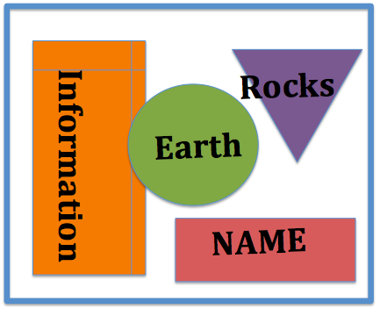
Examples of poster layout

Slide 3
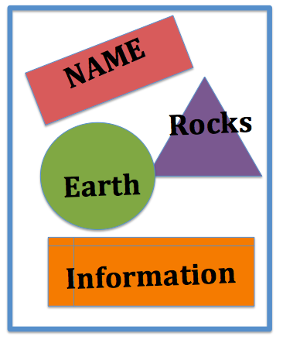
Examples of poster layout

Slide 4
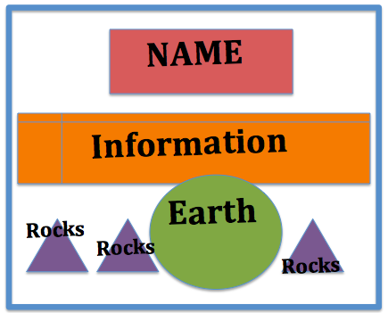
Examples of poster layout

Slide 5
Your poster should have:
4 of the 6 rock identifying properties to identify your rock photo.
3D Diagram of inner Earth, colored and labeled.
AT LEAST 3 sentences about:
what you’ve learned in the last 4 weeks of Saturday Science.
OR what your favorite parts were and why.
Pick 2 questions to reflect on and answer:
Why is it important to study rock and the Earth’s crust?
Explain the difference between between the 3 ways rocks are formed.
Would you ever want to be a geologist? Why or why not?
If you finish all of this, and still have time:
Look back to your collection of data from last week and revise your explanation. Show it to Ms. Emma so you can put it on your poster too

